Slide 1
Exam 2 Database
MentorShip

Slide 2
1. Topic 2. Database

Slide 3
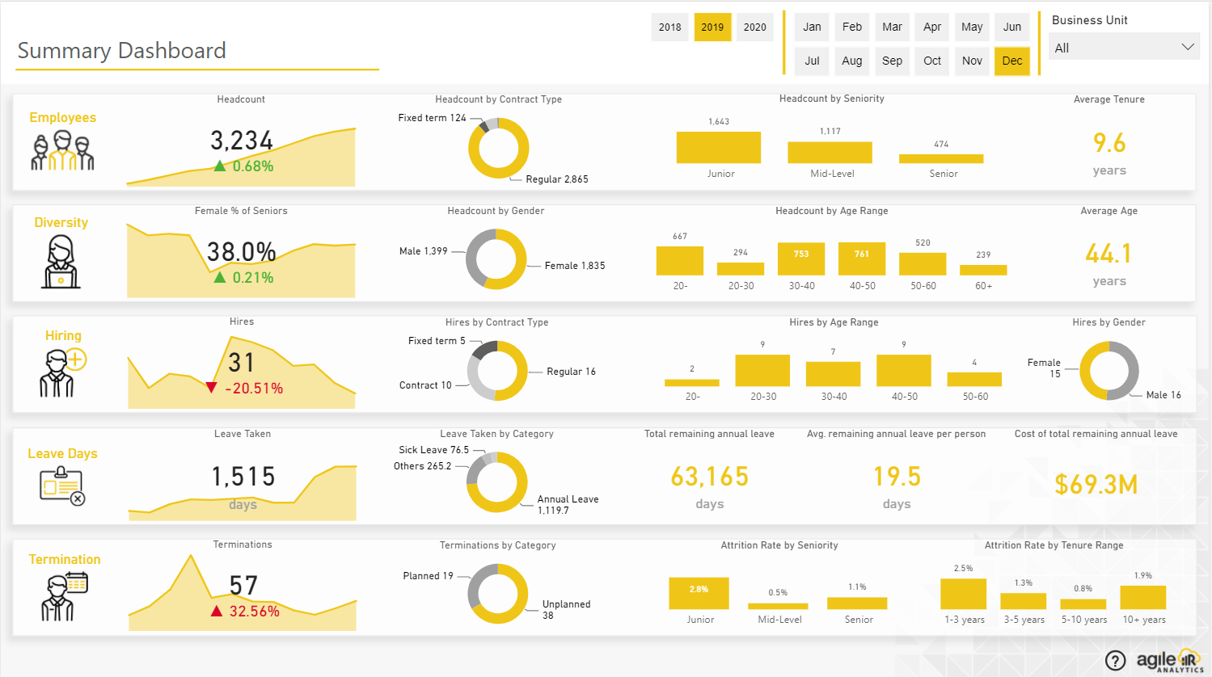
1. Topic

Slide 4
1.Topic
There are active year, month, and business filters applied across the entire query.
Main items on the page.

Slide 5
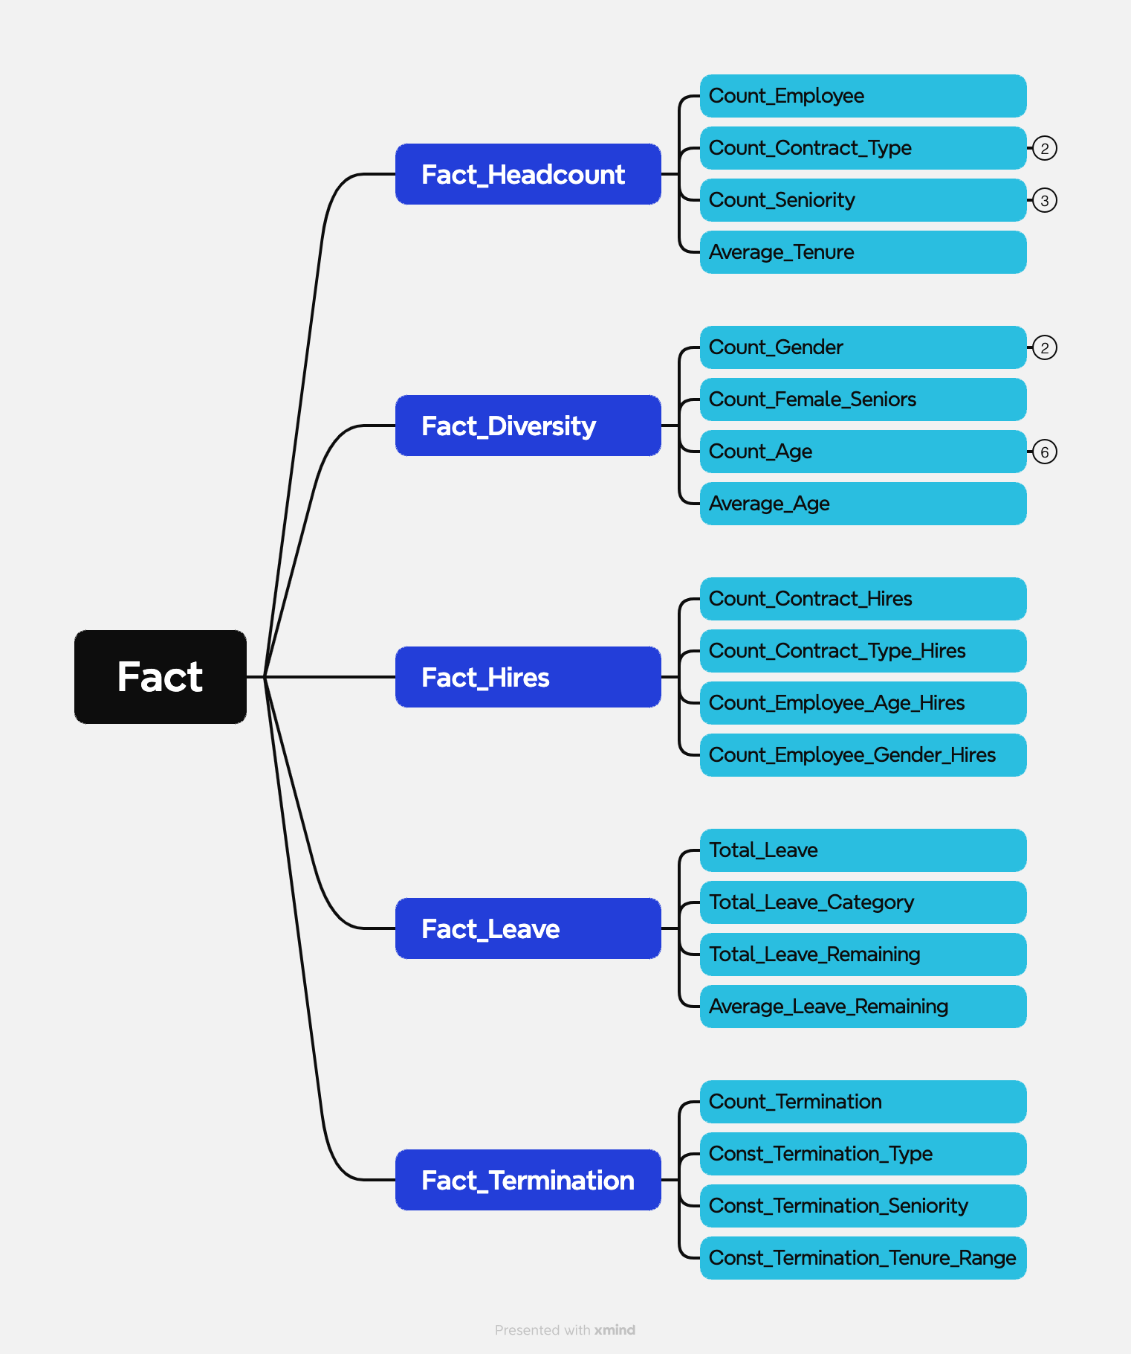
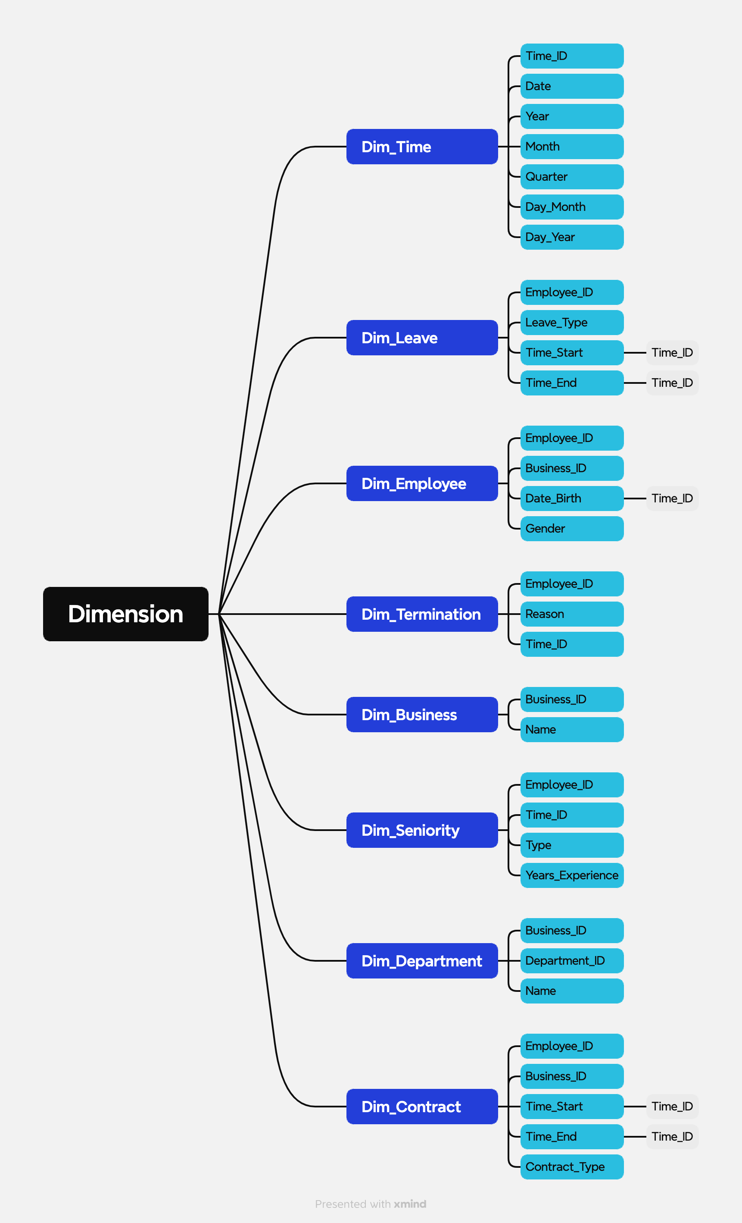
2. Database
https://xmind.app/m/wAK57Q
https://xmind.app/m/wAK57Q

Slide 6
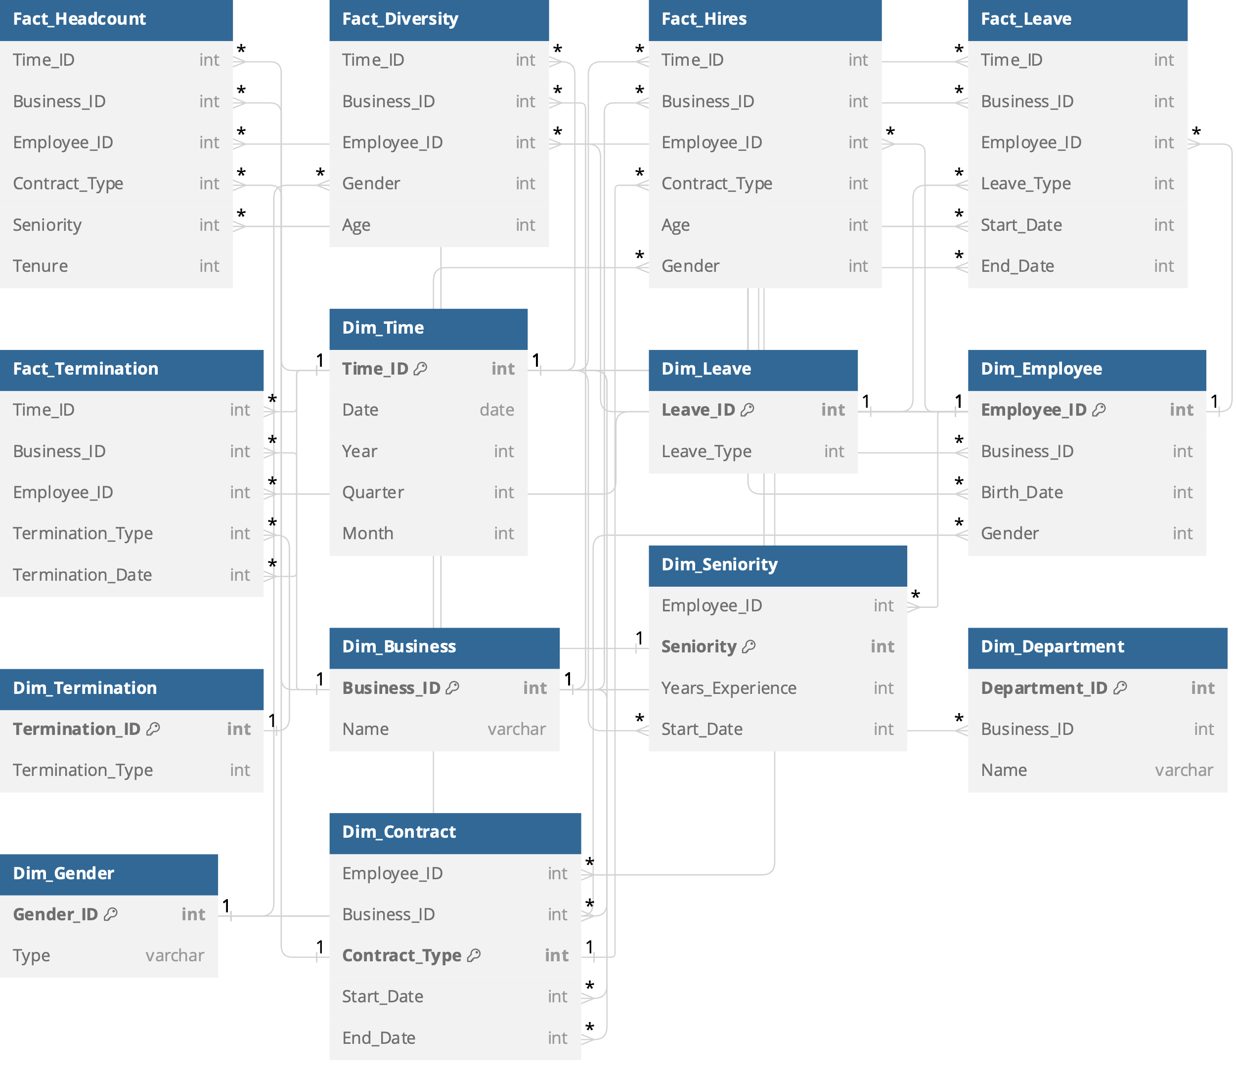
2. Database

Slide 7
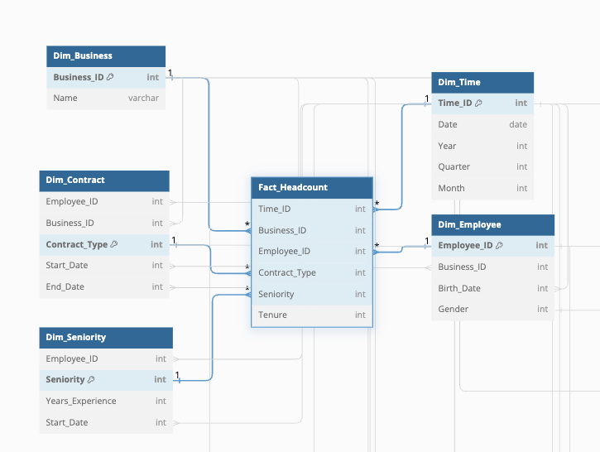
Headcound

Slide 8
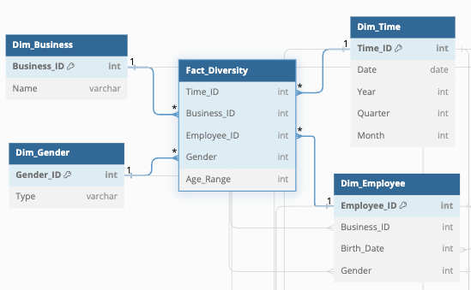
Diversity

Slide 9
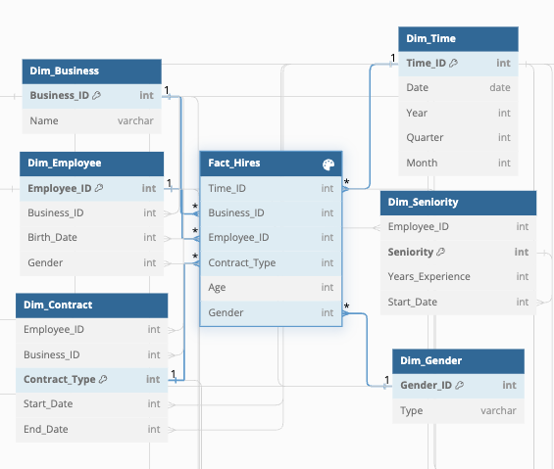
Hiring

Slide 10
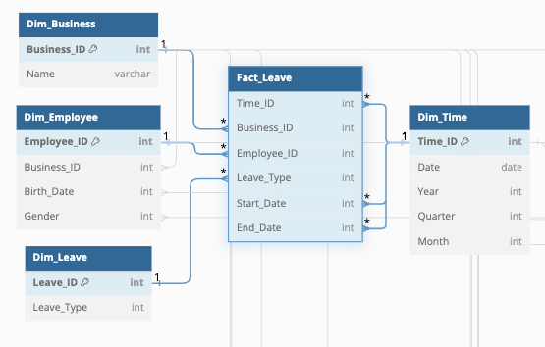
Leave

Slide 11
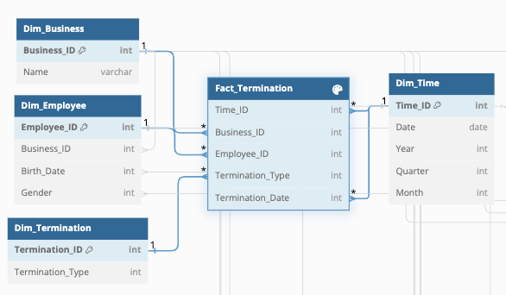
Termination

